Slide 1
PHYS1121/1131 Mechanics
Dr Jan Hamann
(substituting for A/Prof Oleg Tretiakov in Week 1)
Slides by A/Prof Yvonne Wong

Slide 2
Last lecture…

Slide 3
Vectors and scalars…
A vector has a magnitude (“size”) and a direction.
e.g., this arrow going from point A to point B on the xy-plane.
A scalar is a quantity without a direction.
e.g., the length of this arrow, L.
y
y_{B}
B
L
y_{A}
A
x
x_{A}
x_{B}

Slide 4
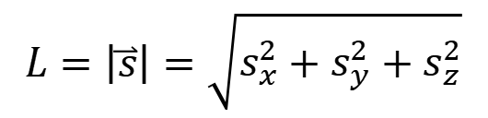




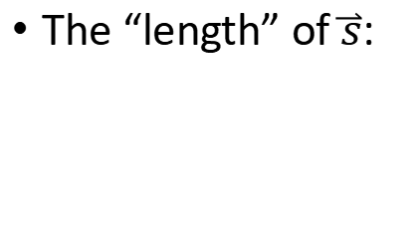


Writing vectors in unit vector notation…
Generalising to 3 dimensions:
$$\hat{k}$$
z
$$\overset{⃑}{s}=s_{x}\hat{x}+s_{y}\hat{y}+s_{z}\hat{z}$$
$$\hat{j}$$
It does not matter which notation you use. But once you’ve picked one, stick with it throughout a calculation.
$$\overset{⃑}{s}$$
$$\hat{i}$$
Or equivalently
$$\overset{⃑}{s}=s_{x}\hat{i}+s_{y}\hat{j}+s_{z}\hat{k}$$
y
The “length” of $\overset{⃑}{s}$:
$$L=\left|\overset{⃑}{s}\right|=\sqrt{s_{x}^{2}+s_{y}^{2}+s_{z}^{2}}$$
x

Slide 5








Adding and subtracting by components…
You can also work directly with the components of the vectors.
y
$$\overset{⃑}{V}$$
$$\overset{⃑}{W}=\overset{⃑}{U}±\overset{⃑}{V}$$
$$φ$$
x-component:
$$W_{x}=U_{x}±V_{x}$$
y-component:
$$W_{y}=U_{y}±V_{y}$$
$$\overset{⃑}{U}$$
$$\overset{⃑}{W}=\left(U_{x}±V_{x}\right)\hat{x}+(U_{y}±V_{y})\hat{y}$$
$$θ$$
x

Slide 6
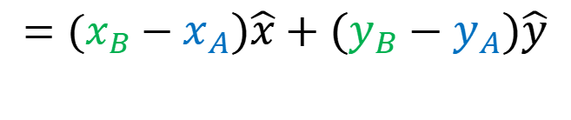





Displacement…
The positions of A and B are described by the position vectors (relative to the origin):
y
y_{B}
B
$${\overset{⃑}{r}}_{A}=x_{A}\hat{x}+y_{A}\hat{y}$$
$${\overset{⃑}{r}}_{B}$$
$$\overset{⃑}{s}$$
$${\overset{⃑}{r}}_{B}=x_{B}\hat{x}+y_{B}\hat{y}$$
y_{A}
A
The displacement from A to B is:
$${\overset{⃑}{r}}_{A}$$
0
x
$$\overset{⃑}{s}={\overset{⃑}{r}}_{B}−{\overset{⃑}{r}}_{A}$$
x_{A}
x_{B}
$$=(x_{B}−x_{A})\hat{x}+(y_{B}−y_{A})\hat{y}$$

Slide 7
Displacement vs distance…
It is important to remember that displacement is a vector. It describes the change in the position of an object (e.g., moving from the point A to the point B).
Distance, on the other hand, is the total path length along which the object travels.
y
y_{B}
B
$$\overset{⃑}{s}$$
y_{A}
A
0
x
x_{A}
x_{B}

Slide 8

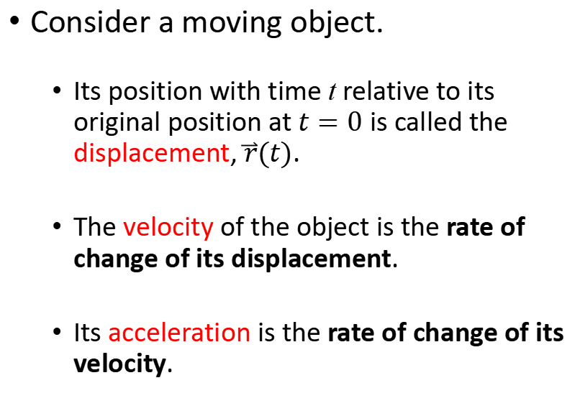
Displacement, velocity, and acceleration…
Consider a moving object.
Its position with time t relative to its original position at $t=0$ is called the displacement, $\overset{⃑}{r}(t)$.
The velocity of the object is the rate of change of its displacement.
Its acceleration is the rate of change of its velocity.
y
y_{B}
B
$$\overset{⃑}{r}(t)$$
y_{A}
A
0
x
x_{A}
x_{B}

Slide 9


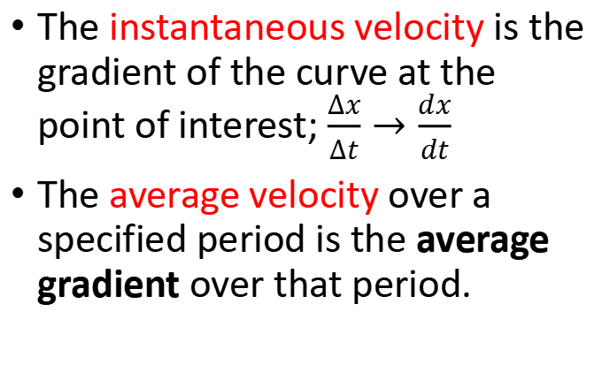
Velocity from displacement vs time graph…
Velocity is the gradient in a displacement vs time graph:
[m]
$\overset{⃑}{v}=\frac{Δ\overset{⃑}{r}}{Δt}$
Or in the 1D case:
$\overset{⃑}{v}=\frac{Δx}{Δt}\hat{x}$
The instantaneous velocity is the gradient of the curve at the point of interest; $\frac{Δx}{Δt}→\frac{dx}{dt}$
The average velocity over a specified period is the average gradient over that period.
[s]

Slide 10
Velocity vs time graph…
You can of course also plot the velocity of an object against time.
[m/s]
[s]
Notes:
Start here stream A 2023.

Slide 11


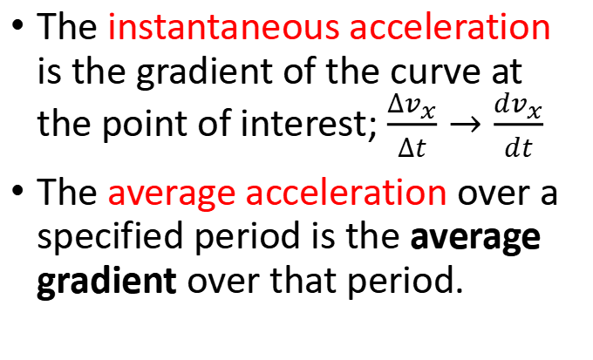
Acceleration from velocity vs time graph…
Acceleration is the gradient in a velocity vs time graph:
$\overset{⃑}{a}=\frac{Δ\overset{⃑}{v}}{Δt}$
Or in the 1D case:
$\overset{⃑}{a}=\frac{Δv_{x}}{Δt}\hat{x}$
[m/s]
The instantaneous acceleration is the gradient of the curve at the point of interest; $\frac{Δv_{x}}{Δt}→\frac{dv_{x}}{dt}$
The average acceleration over a specified period is the average gradient over that period.
[s]

Slide 12
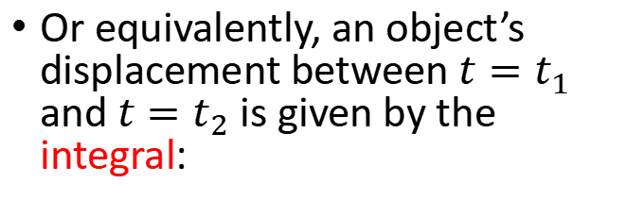
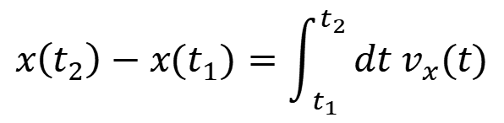
Displacement from velocity vs time graph…
It also works the other way: displacement is the area under an instantaneous velocity vs time graph.
[m/s]
Or equivalently, an object’s displacement between $t=t_{1}$ and $t=t_{2}$ is given by the integral:
$$x\left(t_{2}\right)−x(t_{1})=\int_{t_{1}}^{t_{2}}{{dt v}_{x}(t)}$$
[s]

Slide 13
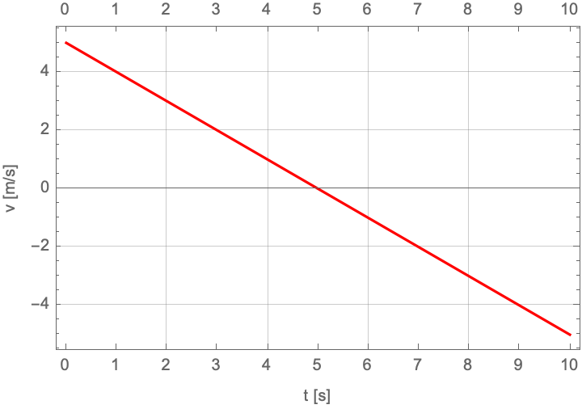



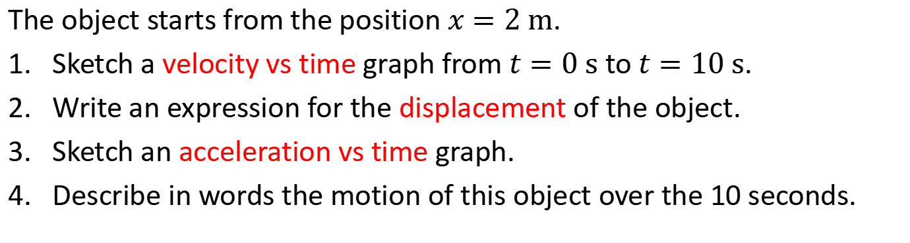

Example 1.7…
The velocity of an object is given by:
$$v(t)=5−t$$
t is in time in units of s
v is velocity in units of m/s
The object starts from the position $x=2 m$.
Sketch a velocity vs time graph from $t=0 s$ to $t=10 s$.
Write an expression for the displacement of the object.
Sketch an acceleration vs time graph.
Describe in words the motion of this object over the 10 seconds.
$$x\left(t\right)−x\left(0\right)=\int_{0}^{t}{dt(5−t)}$$
$$x\left(t\right)=−\frac{t^{2}}{2}+5t+2$$
$$a\left(t\right)=−1$$
Object decelerates and comes to a stop at $t=5 s$. From $t=5 s$, the object accelerates in the negative x-direction.

Slide 14
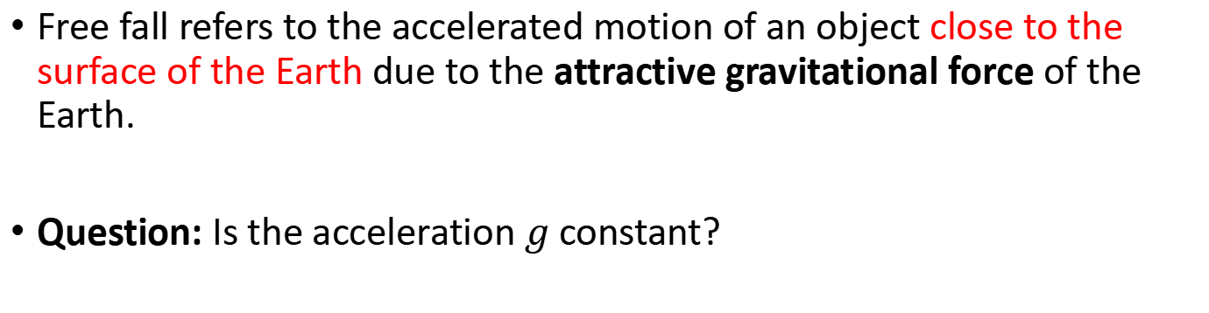
Free fall… 1/2
Free fall refers to the accelerated motion of an object close to the surface of the Earth due to the attractive gravitational force of the Earth.
Question: Is the acceleration $g$ constant?

Slide 15
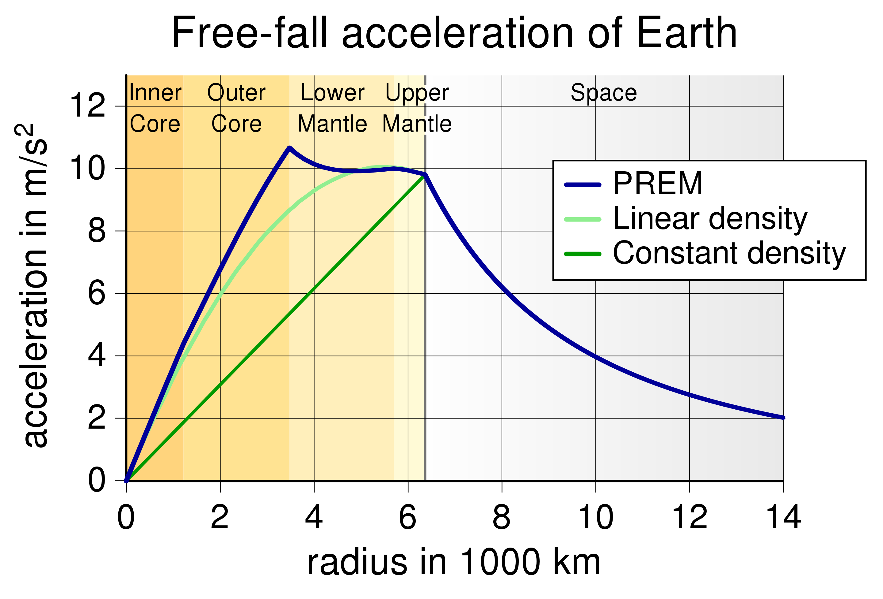
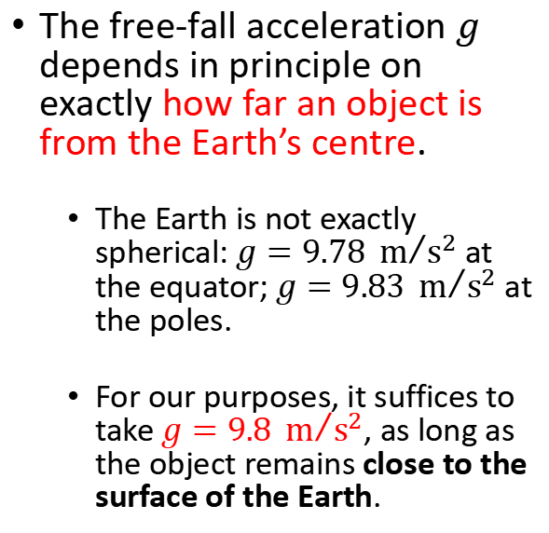
Free fall… 2/2
PREM = Primary Reference Earth Model
The free-fall acceleration $g$ depends in principle on exactly how far an object is from the Earth’s centre.
The Earth is not exactly spherical: $g=9.78 m/{s^{2}}$ at the equator; $g=9.83 m/{s^{2}}$ at the poles.
For our purposes, it suffices to take $g=9.8 m/{s^{2}}$, as long as the object remains close to the surface of the Earth.
3 density models for the Earth.

Slide 16
Example 1.8… 1/2
Draw an acceleration, velocity and displacement graph for a ball dropped from a height of 10 m. Neglect air resistance.

Slide 17
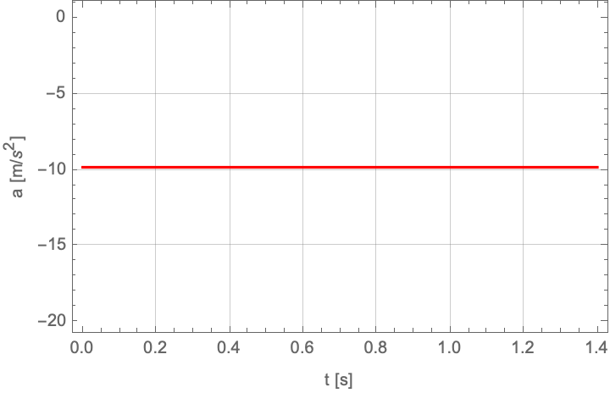
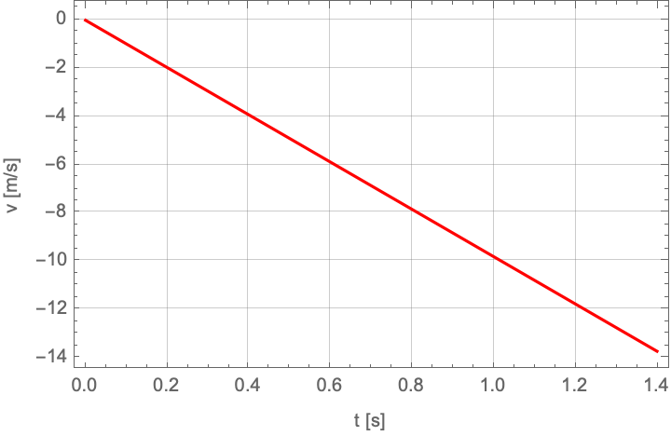
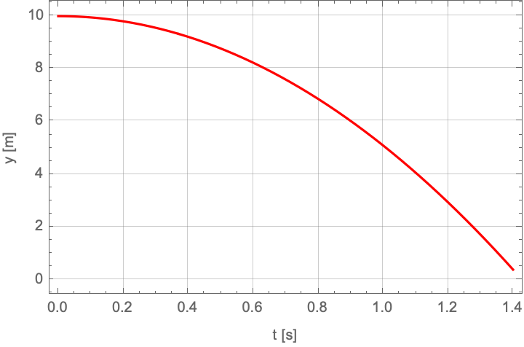




Example 1.8… 2/2
Draw an acceleration, velocity and displacement graph for a ball dropped from a height of $y_{0}=10 m$. Neglect air resistance.
$$\hat{y}$$
$$\overset{⃑}{r}=\left(−\frac{1}{2}gt^{2}+y_{0}\right)\hat{y}$$
$$\overset{⃑}{a}=−g\hat{y}$$
$$\overset{⃑}{v}=−gt \hat{y}$$

Slide 18
Lecture 2…
More than one dimension, kinematic equations, relative velocities; Uniform circular motion, free body diagrams, Newton’s first law…

Slide 19


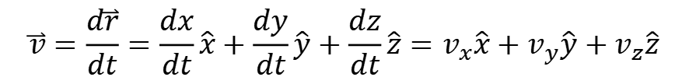
More than one dimension… 1/2
Working with 2D or 3D vectors simply requires that we work with them component by component.
If the displacement vector is:
z
$$\overset{⃑}{r}$$
$$\overset{⃑}{r}=x\hat{x}+y\hat{y}+z\hat{z}$$
Then, the corresponding velocity and acceleration vectors are:
y
$$\overset{⃑}{v}=\frac{d\overset{⃑}{r}}{dt}=\frac{dx}{dt}\hat{x}+\frac{dy}{dt}\hat{y}+\frac{dz}{dt}\hat{z}=v_{x}\hat{x}+v_{y}\hat{y}+v_{z}\hat{z}$$
x
$$\overset{⃑}{a}=\frac{d\overset{⃑}{v}}{dt}=\frac{dv_{x}}{dt}\hat{x}+\frac{dv_{y}}{dt}\hat{y}+\frac{dv_{z}}{dt}\hat{z}=\frac{d^{2}x}{dt^{2}}\hat{x}+\frac{d^{2}y}{dt^{2}}\hat{y}+\frac{d^{2}z}{dt^{2}}\hat{z}=a_{x}\hat{x}+a_{y}\hat{y}+a_{z}\hat{z}$$

Slide 20
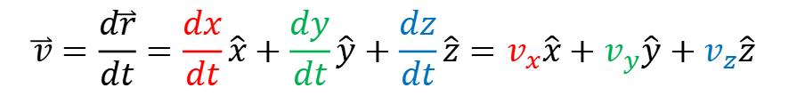
More than one dimension… 1/2
Working with 2D or 3D vectors simply requires that we work with them component by component.
If the displacement vector is:
z
$$\overset{⃑}{r}$$
$$\overset{⃑}{r}=x\hat{x}+y\hat{y}+z\hat{z}$$
Then, the corresponding velocity and acceleration vectors are:
y
$$\overset{⃑}{v}=\frac{d\overset{⃑}{r}}{dt}=\frac{dx}{dt}\hat{x}+\frac{dy}{dt}\hat{y}+\frac{dz}{dt}\hat{z}=v_{x}\hat{x}+v_{y}\hat{y}+v_{z}\hat{z}$$
x
$$\overset{⃑}{a}=\frac{d\overset{⃑}{v}}{dt}=\frac{dv_{x}}{dt}\hat{x}+\frac{dv_{y}}{dt}\hat{y}+\frac{dv_{z}}{dt}\hat{z}=\frac{d^{2}x}{dt^{2}}\hat{x}+\frac{d^{2}y}{dt^{2}}\hat{y}+\frac{d^{2}z}{dt^{2}}\hat{z}=a_{x}\hat{x}+a_{y}\hat{y}+a_{z}\hat{z}$$

Slide 21
More than one dimension… 2/2
Working with 2D or 3D vectors simply requires that we work with them component by component.
If the displacement vector is:
z
$$\overset{⃑}{r}$$
$$\overset{⃑}{r}=x\hat{x}+y\hat{y}+z\hat{z}$$
Then, the corresponding velocity and acceleration vectors are:
y
$$\overset{⃑}{v}=\frac{d\overset{⃑}{r}}{dt}=\frac{dx}{dt}\hat{x}+\frac{dy}{dt}\hat{y}+\frac{dz}{dt}\hat{z}=v_{x}\hat{x}+v_{y}\hat{y}+v_{z}\hat{z}$$
x
$$\overset{⃑}{a}=\frac{d\overset{⃑}{v}}{dt}=\frac{dv_{x}}{dt}\hat{x}+\frac{dv_{y}}{dt}\hat{y}+\frac{dv_{z}}{dt}\hat{z}=\frac{d^{2}x}{dt^{2}}\hat{x}+\frac{d^{2}y}{dt^{2}}\hat{y}+\frac{d^{2}z}{dt^{2}}\hat{z}=a_{x}\hat{x}+a_{y}\hat{y}+a_{z}\hat{z}$$

Slide 22


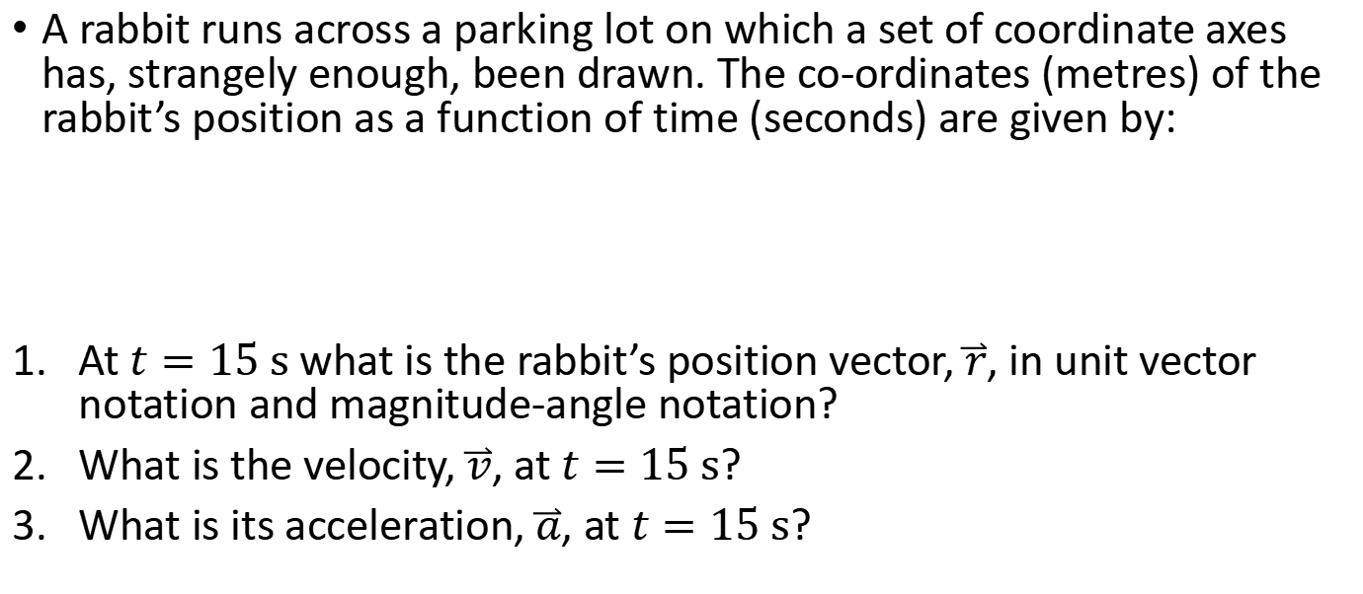
Example 2.1… 1/2
A rabbit runs across a parking lot on which a set of coordinate axes has, strangely enough, been drawn. The co-ordinates (metres) of the rabbit’s position as a function of time (seconds) are given by:
At $t=15 s$ what is the rabbit’s position vector, $\overset{⃑}{r}$, in unit vector notation and magnitude-angle notation?
What is the velocity, $\overset{⃑}{v}$, at $t=15 s$?
What is its acceleration, $\overset{⃑}{a}$, at $t=15 s$?
$$x=−0.31 t^{2}+7.2t+28$$
$$y=0.22 t^{2}−9.1t+30$$

Slide 23




Example 2.1… 2/2
A rabbit runs across a parking lot on which a set of coordinate axes has, strangely enough, been drawn. The co-ordinates (metres) of the rabbit’s position as a function of time (seconds) are given by:
At $t=15 s$ what is the rabbit’s position vector, $\overset{⃑}{r}$, in unit vector notation and magnitude-angle notation?
What is the velocity, $\overset{⃑}{v}$, at $t=15 s$?
What is its acceleration, $\overset{⃑}{a}$, at $t=15 s$?
$$x=−0.31 t^{2}+7.2t+28$$
$$y=0.22 t^{2}−9.1t+30$$
$$θ=−41°$$
$$\overset{⃑}{r}=\left(66\hat{x}−57\hat{y}\right) m=87\left(\cos{θ}\hat{x}+\sin{θ}\hat{y}\right) m$$
$$v_{x}=7.2−0.62 t$$
$$v_{y}=−9.1+0.44t$$
$$\overset{⃑}{v}=\left(−2.1\hat{x}−2.5\hat{y}\right) m/s$$
$$\overset{⃑}{a}=\left(−0.62\hat{x}+0.44\hat{y}\right) m/s^{2}$$

Slide 24
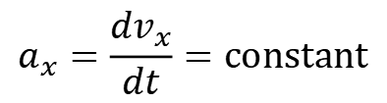
Kinematic equations… 1/5
If acceleration is constant in one (or more) direction, e.g., an object undergoing free fall, we can describe the motion of an object in that direction using kinematic equations.
Consider the x-direction where the acceleration is
$$a_{x}=\frac{dv_{x}}{dt}=constant$$

Slide 25
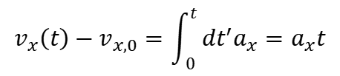
Kinematic equations… 2/5
If acceleration is constant in one (or more) direction, e.g., an object undergoing free fall, we can describe the motion of an object in that direction using kinematic equations.
Consider the x-direction where the acceleration is
$$a_{x}=\frac{dv_{x}}{dt}=constant$$
x-velocity at t
Initial velocity at t=0
$$v_{x}\left(t\right)−v_{x,0}=\int_{0}^{t}{dt^{′}a_{x}}=a_{x}t$$
Integrating once gives:

Slide 26

Kinematic equations… 3/5
If acceleration is constant in one (or more) direction, e.g., an object undergoing free fall, we can describe the motion of an object in that direction using kinematic equations.
Consider the x-direction where the acceleration is
$$a_{x}=\frac{dv_{x}}{dt}=constant$$
x-velocity at t
Initial velocity at t=0
$$v_{x}\left(t\right)−v_{x,0}=\int_{0}^{t}{dt^{′}a_{x}}=a_{x}t$$
Integrating once gives:
$$v_{x}\left(t\right)=v_{x,0}+a_{x}t$$

Slide 27
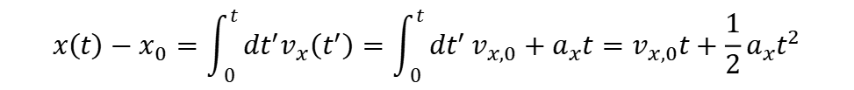
Kinematic equations… 4/5
If acceleration is constant in one (or more) direction, e.g., an object undergoing free fall, we can describe the motion of an object in that direction using kinematic equations.
Consider the x-direction where the acceleration is
$$a_{x}=\frac{dv_{x}}{dt}=constant$$
x-velocity at t
Initial velocity at t=0
$$v_{x}\left(t\right)−v_{x,0}=\int_{0}^{t}{dt^{′}a_{x}}=a_{x}t$$
Integrating once gives:
$$v_{x}\left(t\right)=v_{x,0}+a_{x}t$$
Initial position at t=0
$$x\left(t\right)−x_{0}=\int_{0}^{t}{dt^{′}v_{x}\left(t^{′}\right)}={\int_{0}^{t}{dt^{′}}v}_{x,0}+a_{x}t=v_{x,0}t+\frac{1}{2}a_{x}t^{2}$$
Integrating again gives:

Slide 28


Kinematic equations… 5/5
If acceleration is constant in one (or more) direction, e.g., an object undergoing free fall, we can describe the motion of an object in that direction using kinematic equations.
Consider the x-direction where the acceleration is
$$a_{x}=\frac{dv_{x}}{dt}=constant$$
x-velocity at t
Initial velocity at t=0
$$v_{x}\left(t\right)−v_{x,0}=\int_{0}^{t}{dt^{′}a_{x}}=a_{x}t$$
Integrating once gives:
$$v_{x}\left(t\right)=v_{x,0}+a_{x}t$$
Initial position at t=0
$$x\left(t\right)−x_{0}=\int_{0}^{t}{dt^{′}v_{x}\left(t^{′}\right)}={\int_{0}^{t}{dt^{′}}v}_{x,0}+a_{x}t=v_{x,0}t+\frac{1}{2}a_{x}t^{2}$$
Integrating again gives:
Displacement
$$=s\left(t\right)$$
$$s\left(t\right)=v_{x,0}t+\frac{1}{2}a_{x}t^{2}$$

Slide 29
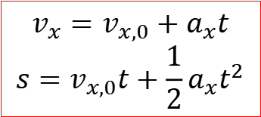
Kinematic equations, one more… 1/3
From the previous two equations, we can derive a third relation.
$$v_{x}=v_{x,0}+a_{x}t$$
$$s=v_{x,0}t+\frac{1}{2}a_{x}t^{2}$$
$$v_{x}^{2}={\left(v_{x,0}+a_{x}t\right)}^{2}=v_{x,0}^{2}+2v_{x,0}a_{x}t+a_{x}^{2}t^{2}$$

Slide 30
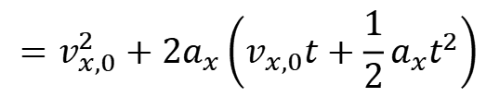
Kinematic equations, one more… 2/3
From the previous two equations, we can derive a third relation.
$$v_{x}=v_{x,0}+a_{x}t$$
$$s=v_{x,0}t+\frac{1}{2}a_{x}t^{2}$$
$$v_{x}^{2}={\left(v_{x,0}+a_{x}t\right)}^{2}=v_{x,0}^{2}+2v_{x,0}a_{x}t+a_{x}^{2}t^{2}$$
$$=v_{x,0}^{2}+2a_{x}\left(v_{x,0}t+\frac{1}{2}a_{x}t^{2}\right)$$

Slide 31

Kinematic equations, one more… 3/3
From the previous two equations, we can derive a third relation.
$$v_{x}=v_{x,0}+a_{x}t$$
$$s=v_{x,0}t+\frac{1}{2}a_{x}t^{2}$$
$$v_{x}^{2}={\left(v_{x,0}+a_{x}t\right)}^{2}=v_{x,0}^{2}+2v_{x,0}a_{x}t+a_{x}^{2}t^{2}$$
$$=v_{x,0}^{2}+2a_{x}\left(v_{x,0}t+\frac{1}{2}a_{x}t^{2}\right)$$
This expression is ultimately related to energy/work; more later.
$$v_{x}^{2}=v_{x,0}^{2}+2a_{x}s$$

Slide 32


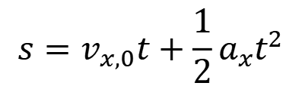
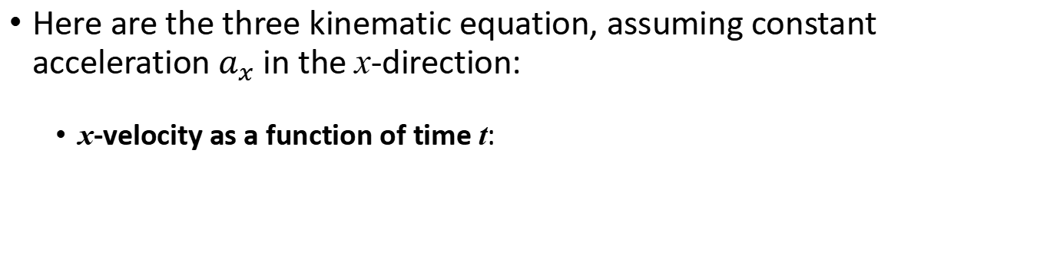
Kinematic equations: summary…
Here are the three kinematic equation, assuming constant acceleration $a_{x}$ in the x-direction:
x-velocity as a function of time t:
Initial velocity at t=0
$$v_{x}=v_{x,0}+a_{x}t$$
x-displacement as a function of time t:
$$s=v_{x,0}t+\frac{1}{2}a_{x}t^{2}$$
Combine them:
$$v_{x}^{2}=v_{x,0}^{2}+2a_{x}s$$

Slide 33
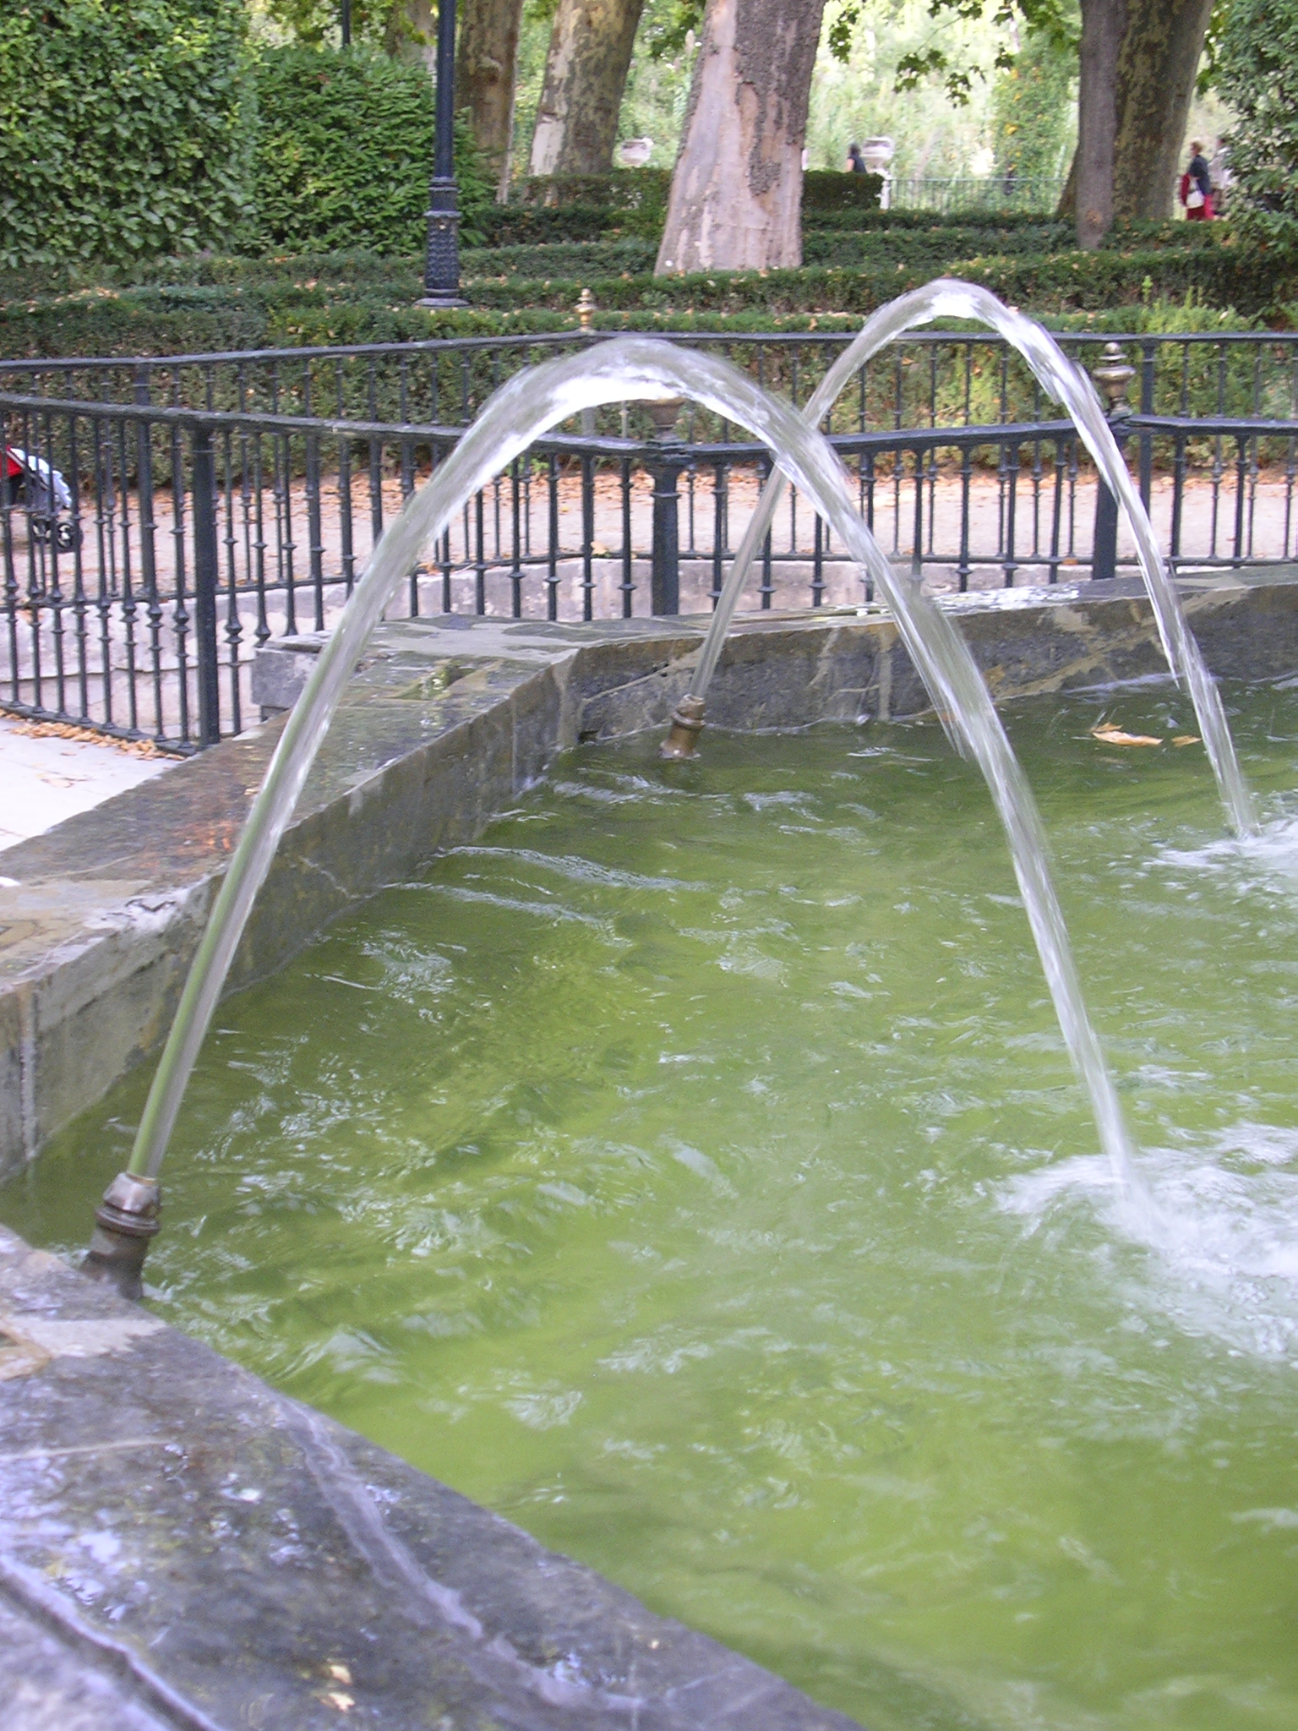
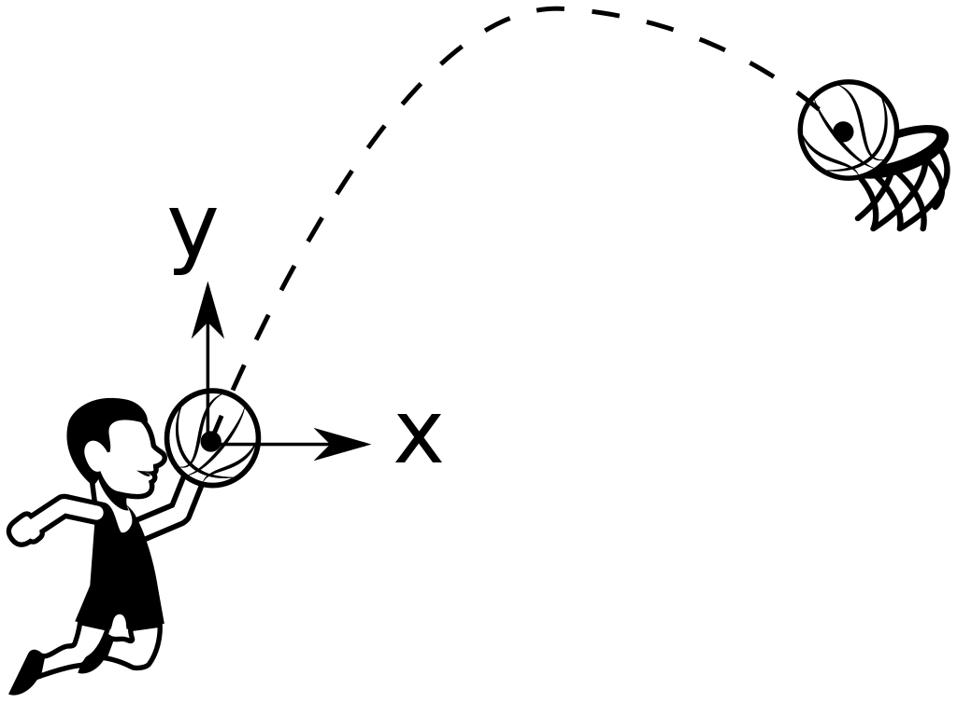
Projectile motion… 1/4
Motion of an object thrown into the air.

Slide 34
Projectile motion… 2/4
Motion of an object thrown into the air.
Motion in 2 dimensions (vertical and horizontal), where the vertical direction is subject to constant acceleration due to gravity (if close to the surface of Earth).
In the absence of air resistance, there is no other force at play.
We can describe the motion in terms of what happens to the object in the horizontal x-direction and the vertical y-direction.

Slide 35
Projectile motion… 3/4
Motion of an object thrown into the air.
Motion in 2 dimensions (vertical and horizontal), where the vertical direction is subject to constant acceleration due to gravity (if close to the surface of Earth).
In the absence of air resistance, there is no other force at play.
We can describe the motion in terms of what happens to the object in the horizontal x-direction and the vertical y-direction.

Slide 36
Projectile motion… 4/4
Question: Two identical balls are launched from the same height, one with no horizontal velocity and one with horizontal velocity of 1 m/s.
Which will hit the floor first?
Notes:
Demo with projecting and dropping ball.

Slide 37
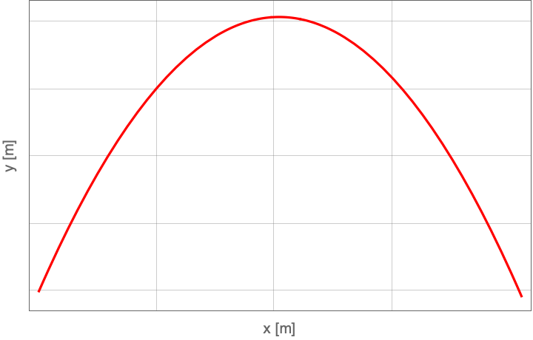




Range of a projectile… 1/4
We can use the kinematic equations to derive an expression for the maximum height $h$, time of flight $T$, and range $X$ of a projectile launched with initial speed $u$ at an angle $θ$ above the horizontal.
$$h$$
$$\overset{⃑}{u}$$
$$θ$$
$$X$$
Notes:
Check with strobe and water.

Slide 38


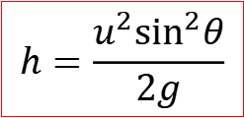




Range of a projectile… 2/4
We can use the kinematic equations to derive an expression for the maximum height $h$, time of flight $T$, and range $X$ of a projectile launched with initial speed $u$ at an angle $θ$ above the horizontal.
For the maximum height $h$, use:
Displacement $s→h$
$$v^{2}=v_{0}^{2}+2as$$
At $y=h$, the vertical speed is 0.
Acceleration is $a=−g$
$$h$$
$$v_{0}=u\sin{θ}$$
$$\overset{⃑}{u}$$
$$0=u^{2}\sin^{2}θ−2gh$$
$$θ$$
$$X$$
$$h=\frac{{u^{2}sin}^{2}θ}{2g}$$
Notes:
Check with strobe and water.

Slide 39

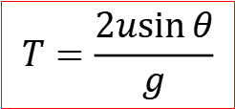


Range of a projectile… 3/4
We can use the kinematic equations to derive an expression for the maximum height $h$, time of flight $T$, and range $X$ of a projectile launched with initial speed $u$ at an angle $θ$ above the horizontal.
For the time of flight $T$, use:
$$v=v_{0}+at$$
Projectile reaches $h$ at $t=T/2$.
At $y=h$, the vertical speed is 0.
$$h$$
Acceleration is $a=−g$
$$v_{0}=u\sin{θ}$$
$$\overset{⃑}{u}$$
$$0=u\sin{θ}−gT/2$$
$$θ$$
$$X$$
$$T=\frac{2u\sin{θ}}{g}$$
Notes:
Check with strobe and water.

Slide 40


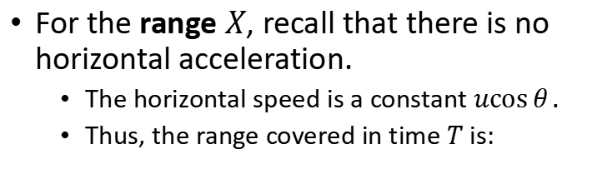
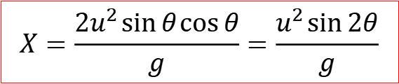
Range of a projectile… 4/4
We can use the kinematic equations to derive an expression for the maximum height $h$, time of flight $T$, and range $X$ of a projectile launched with initial speed $u$ at an angle $θ$ above the horizontal.
For the range $X$, recall that there is no horizontal acceleration.
The horizontal speed is a constant $u\cos{θ}.$
Thus, the range covered in time $T$ is:
$$h$$
$$T=\frac{2u\sin{θ}}{g}$$
$$X=u\cos{θ}× T$$
Time of flight
$$\overset{⃑}{u}$$
$$θ$$
$$X=\frac{2u^{2}\sin{θ}\cos{θ}}{g}=\frac{u^{2}\sin{2θ}}{g}$$
$$X$$
Notes:
Check with strobe and water.

Slide 41






Reference frames… 1/4
Consider two reference frames.
Alex is at stationary. He defines a frames with respect to himself, x.
Barbara moves in the x-direction with a speed $v_{BA}$ relative to Alex. She also defines a frame with respect to herself, x’.
Alex observes the object P to be at $x_{P}$ in his reference frame. Barbara observes it to be at $x_{P}^{′}$ in her frame. How are $x_{P}$ and $x_{P}^{′}$ related?
A reference frame is a coordinate system defined with respect to a reference point.
$$x$$
$$x′$$
$$v_{BA}$$

Slide 42


Reference frames… 2/4
Consider two reference frames.
Alex is at stationary. He defines a frames with respect to himself, x.
Barbara moves in the x-direction with a speed $v_{BA}$ relative to Alex. She also defines a frame with respect to herself, x’.
Alex observes the object P to be at $x_{P}$ in his reference frame. Barbara observes it to be at $x_{P}^{′}$ in her frame. How are $x_{P}$ and $x_{P}^{′}$ related?
$$x_{P}$$
A reference frame is a coordinate system defined with respect to a reference point.
$$x$$
P
$$x′$$
$$x_{P}^{′}$$
$$v_{BA}$$

Slide 43

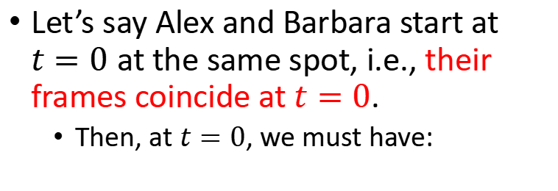
Reference frames… 3/4
Let’s say Alex and Barbara start at $t=0$ at the same spot, i.e., their frames coincide at $t=0$.
Then, at $t=0$, we must have:
$$x_{P}$$
$$x$$
P
$$x_{P}=x_{P}^{′}$$
$$x′$$
$$x_{P}^{′}$$
$$v_{BA}$$

Slide 44



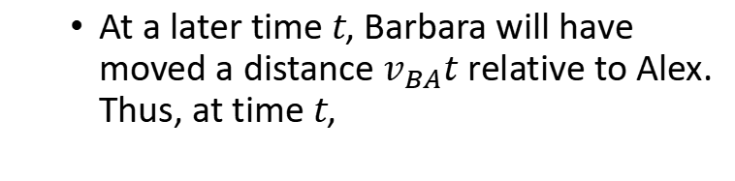
Reference frames… 4/4
Let’s say Alex and Barbara start at $t=0$ at the same spot, i.e., their frames coincide at $t=0$.
Then, at $t=0$, we must have:
$$x_{P}$$
$$x$$
P
$$x_{P}=x_{P}^{′}$$
At a later time t, Barbara will have moved a distance $v_{BA}t$ relative to Alex. Thus, at time t,
$$v_{BA}t$$
$$x′$$
$$x_{P}^{′}$$
$$x_{P}=x_{P}^{′}+v_{BA}t$$
Rearrange:
$$x_{P}^{′}=x_{P}−v_{BA}t$$
$$v_{BA}$$

Slide 45
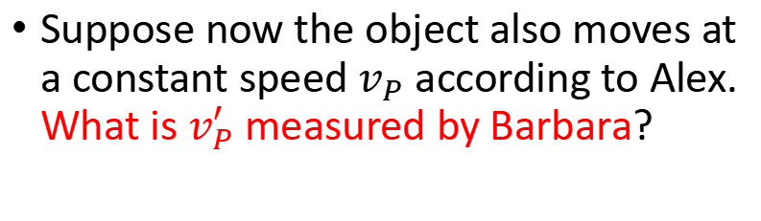
Relative velocities… 1/4
We just established that:
$$x_{P}$$
$$x_{P}^{′}=x_{P}−v_{BA}t$$
$$x$$
Suppose now the object also moves at a constant speed $v_{P}$ according to Alex. What is $v_{P}^{′}$ measured by Barbara?
P
$$v_{BA}t$$
$$x′$$
$$x_{P}^{′}$$
$$v_{BA}$$

Slide 46

Relative velocities… 2/4
We just established that:
$$x_{P}$$
$$x_{P}^{′}=x_{P}−v_{BA}t$$
$$x$$
Suppose now the object also moves at a constant speed $v_{P}$ according to Alex. What is $v_{P}^{′}$ measured by Barbara?
P
$$v_{P}^{′}=\frac{dx_{P}^{′}}{dt}$$
$$v_{BA}t$$
$$x′$$
$$x_{P}^{′}$$
$$v_{BA}$$

Slide 47


Relative velocities… 3/4
We just established that:
$$x_{P}$$
$$x_{P}^{′}=x_{P}−v_{BA}t$$
$$x$$
Suppose now the object also moves at a constant speed $v_{P}$ according to Alex. What is $v_{P}^{′}$ measured by Barbara?
P
$$v_{P}^{′}=\frac{dx_{P}^{′}}{dt}$$
$$=\frac{dx_{P}}{dt}−v_{BA}$$
$$v_{BA}t$$
Using relation above
$$x′$$
$$x_{P}^{′}$$
$${=v}_{P}$$
$$v_{BA}$$

Slide 48
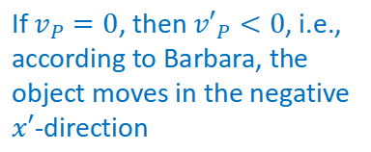

Relative velocities… 4/4
We just established that:
$$x_{P}$$
$$x_{P}^{′}=x_{P}−v_{BA}t$$
$$x$$
Suppose now the object also moves at a constant speed $v_{P}$ according to Alex. What is $v_{P}^{′}$ measured by Barbara?
P
$$v_{P}^{′}=\frac{dx_{P}^{′}}{dt}$$
$$=\frac{dx_{P}}{dt}−v_{BA}$$
$$v_{BA}t$$
Using relation above
$$x′$$
$$x_{P}^{′}$$
$${=v}_{P}$$
If $v_{P}=0$, then ${v′}_{P}<0$, i.e., according to Barbara, the object moves in the negative $x′$-direction
$$v_{P}^{′}=v_{P}−v_{BA}$$
$$v_{BA}$$

Slide 49



In more than one dimension…
The previous expressions hold for multiple dimensions as well.
One dimension
More than one dimension
Position
$$x_{P}^{′}=x_{P}−v_{BA}t$$
$${\overset{⃑}{x}}_{P}^{′}={\overset{⃑}{x}}_{P}−{\overset{⃑}{v}}_{BA}t$$
Velocity
$$v_{P}^{′}=v_{P}−v_{BA}$$
$${\overset{⃑}{v}}_{P}^{′}={\overset{⃑}{v}}_{P}−{\overset{⃑}{v}}_{BA}$$
Again, when working with more than one dimension, work with the vectors by components, e.g., consider all the x-components first, then all the y-components, etc.

Slide 50
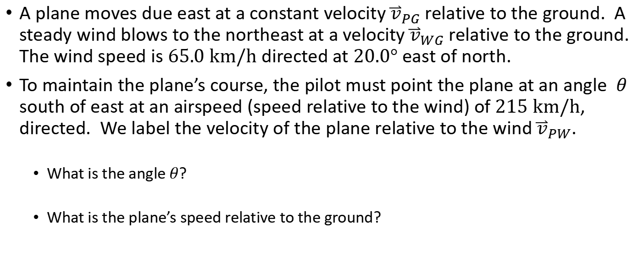
Example 2.2… 1/2
A plane moves due east at a constant velocity ${\overset{⃑}{v}}_{PG}$ relative to the ground. A steady wind blows to the northeast at a velocity ${\overset{⃑}{v}}_{WG}$ relative to the ground. The wind speed is $65.0 km/h$ directed at $20.0°$ east of north.
To maintain the plane’s course, the pilot must point the plane at an angle $θ$ south of east at an airspeed (speed relative to the wind) of $215 km/h$, directed. We label the velocity of the plane relative to the wind ${\overset{⃑}{v}}_{PW}$.
What is the angle $θ$?
What is the plane’s speed relative to the ground?

Slide 51
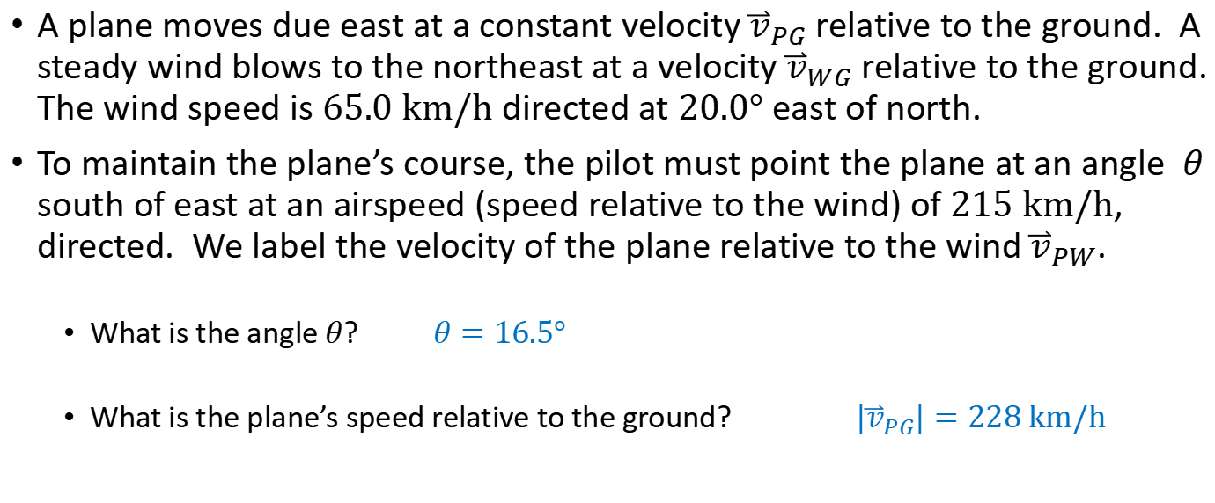
Example 2.2… 2/2
A plane moves due east at a constant velocity ${\overset{⃑}{v}}_{PG}$ relative to the ground. A steady wind blows to the northeast at a velocity ${\overset{⃑}{v}}_{WG}$ relative to the ground. The wind speed is $65.0 km/h$ directed at $20.0°$ east of north.
To maintain the plane’s course, the pilot must point the plane at an angle $θ$ south of east at an airspeed (speed relative to the wind) of $215 km/h$, directed. We label the velocity of the plane relative to the wind ${\overset{⃑}{v}}_{PW}$.
What is the angle $θ$? $θ=16.5°$
What is the plane’s speed relative to the ground? $\left|{\overset{⃑}{v}}_{PG}\right|=228 km/h$
See blackboard

Slide 52

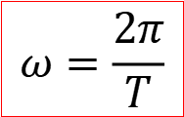
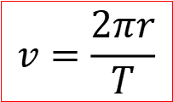
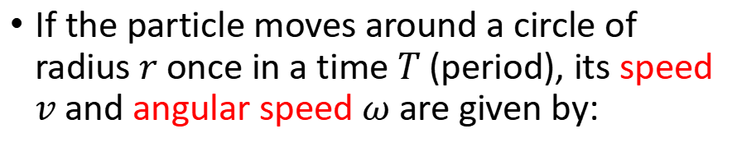
Uniform circular motion… 1/6
A particle undergoes uniform circular motion if it travels around a circle at constant speed.
If the particle moves around a circle of radius $r$ once in a time $T$ (period), its speed $v$ and angular speed $ω$ are given by:
$$r$$
$$v=\frac{2πr}{T}$$
$$ω=\frac{2π}{T}$$
Angular speed (radians per unit time)
Speed
What about its acceleration?

Slide 53




Uniform circular motion… 2/6
Let’s write down first the particle’s displacement:
$$\overset{⃑}{s}=r\cos{θ \hat{x}}+r\sin{θ}\hat{y}$$
$\overset{⃑}{s}$ points radially outwards
$$y$$
$$\overset{⃑}{s}$$
$$r$$
$$θ$$
$$x$$

Slide 54




Uniform circular motion… 3/6
Let’s write down first the particle’s displacement:
$$\overset{⃑}{s}=r\cos{θ \hat{x}}+r\sin{θ}\hat{y}$$
$\overset{⃑}{s}$ points radially outwards
$$y$$
$$θ=ωt$$
If at $θ=0$ at $t=0$:
$$=r\cos{(ωt) \hat{x}}+r\sin{(ωt)}\hat{y}$$
$$\overset{⃑}{s}$$
$$r$$
$ω=$ angular speed
$$θ$$
$$x$$

Slide 55
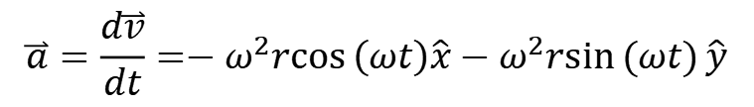
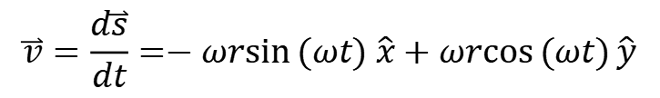
Uniform circular motion… 4/6
Let’s write down first the particle’s displacement:
$$\overset{⃑}{s}=r\cos{θ \hat{x}}+r\sin{θ}\hat{y}$$
$\overset{⃑}{s}$ points radially outwards
$$y$$
$$θ=ωt$$
If at $θ=0$ at $t=0$:
$$=r\cos{(ωt) \hat{x}}+r\sin{(ωt)}\hat{y}$$
$$\overset{⃑}{s}$$
$$r$$
$ω=$ angular speed
$$θ$$
$$x$$
Derive velocity and acceleration:
$$\overset{⃑}{v}=\frac{d\overset{⃑}{s}}{dt}=−ωr\sin{(ωt) \hat{x}}+ωr\cos{(ωt)}\hat{y}$$
$$\overset{⃑}{a}=\frac{d\overset{⃑}{v}}{dt}=−ω^{2}r\cos\left(ωt\right)\hat{x}−ω^{2}r\sin{(ωt)}\hat{y}$$

Slide 56


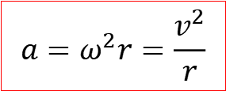

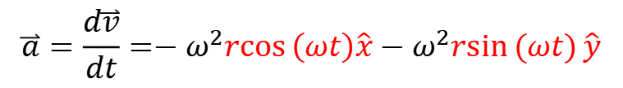
Uniform circular motion… 5/6
Let’s write down first the particle’s displacement:
$$\overset{⃑}{s}=r\cos{θ \hat{x}}+r\sin{θ}\hat{y}$$
$\overset{⃑}{s}$ points radially outwards
$$y$$
$$θ=ωt$$
$$\overset{⃑}{a}$$
If at $θ=0$ at $t=0$:
$$=r\cos{(ωt) \hat{x}}+r\sin{(ωt)}\hat{y}$$
$$\overset{⃑}{s}$$
$$r$$
$ω=$ angular speed
$$θ$$
$$x$$
Derive velocity and acceleration:
$$\overset{⃑}{v}=\frac{d\overset{⃑}{s}}{dt}=−ωr\sin{(ωt) \hat{x}}+ωr\cos{(ωt)}\hat{y}$$
$$\overset{⃑}{a}=\frac{d\overset{⃑}{v}}{dt}=−ω^{2}r\cos\left(ωt\right)\hat{x}−ω^{2}r\sin{(ωt)}\hat{y}$$
$$a=ω^{2}r=\frac{v^{2}}{r}$$
Centripetal acceleration
$$=−ω^{2}\overset{⃑}{s}$$
$\overset{⃑}{a}$ points radially inwards: we therefore call it centripetal acceleration.

Slide 57
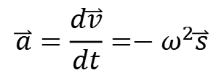


Uniform circular motion… 6/6
Here’s the acceleration again:
$$\overset{⃑}{a}=\frac{d\overset{⃑}{v}}{dt}=−ω^{2}\overset{⃑}{s}$$
$$a_{T}=0$$
$ω=$ angular speed
$$y$$
$$θ=ωt$$
$$\overset{⃑}{a}$$
$$\overset{⃑}{s}$$
$\overset{⃑}{s}$ points radially outwards, so $\overset{⃑}{a}$ points radially inwards.
There is no acceleration in the tangential direction., i.e., $a_{T}=0$.
Zero tangential acceleration $a_{T}=0$ is a feature of uniform circular motion.
If $a_{T}≠0$, then the motion not uniform circular motion.
$$r$$
$$θ$$
$$x$$

Slide 58
Example 2.3… 1/3
A woman rides a carnival Ferris wheel at radius 15 m, completing five turns about its horizontal axis every minute. Given that the Ferris wheel turns at a constant rate what is:
The period of the motion?
The magnitude and direction of her centripetal acceleration at the highest point?
The magnitude and direction of her centripetal acceleration at the lowest point?

Slide 59

Example 2.3… 2/3
A woman rides a carnival Ferris wheel at radius 15 m, completing five turns about its horizontal axis every minute. Given that the Ferris wheel turns at a constant rate what is:
The period of the motion?
The magnitude and direction of her centripetal acceleration at the highest point?
The magnitude and direction of her centripetal acceleration at the lowest point?
$$y$$
5 turns in 60 s → 1 turn in 12 s
$$T=12 s$$

Slide 60





Example 2.3… 3/3
A woman rides a carnival Ferris wheel at radius 15 m, completing five turns about its horizontal axis every minute. Given that the Ferris wheel turns at a constant rate what is:
The period of the motion?
The magnitude and direction of her centripetal acceleration at the highest point?
The magnitude and direction of her centripetal acceleration at the lowest point?
$$y$$
5 turns in 60 s → 1 turn in 12 s
$$T=12 s$$
Centripetal acceleration:
$$a=ω^{2}r$$
$$ω=\frac{2π}{T}$$
Angular speed:
$$a={\left(\frac{2π}{T}\right)}^{2}r=49 m/{s^{2}}$$
Highest point:
$$\overset{⃑}{a}∝−\hat{y}$$
Lowest point:
$$\overset{⃑}{a}∝\hat{y}$$

Slide 61
Free body diagrams… 1/2
A free body diagrams shows:
All the forces acting on a body.
The direction of the forces acting on the body.
The relative size of the forces acting on the body.

Slide 62

Free body diagrams… 2/2
A free body diagrams shows:
All the forces acting on a body.
The direction of the forces acting on the body.
The relative size of the forces acting on the body.
Free body diagram for a falling object:
$${\overset{⃑}{F}}_{grav}$$

Slide 63

Free body diagram for the central mass… 1/2

Slide 64



Free body diagram for the central mass… 2/2
$${\overset{⃑}{T}}_{1}$$
$${\overset{⃑}{T}}_{2}$$
$\overset{⃑}{T}$ = tension in the string
$${\overset{⃑}{F}}_{grav}$$

Slide 65

Problem 2.1…
A cart is propelled over an xy-plane with acceleration components $ax=4.0 m/s2$ and $ay=−2.0 m/s2$. Its initial velocity has components $v0x=8.0 m/s$ and $v0y=12 m/s$.
In unit vector notation, what is the velocity of the cart when it reaches its greatest y coordinate?

Slide 66
Problem 2.2…
A certain airplane has a speed of 290.0 km/h and is diving at an angle 30.0º below the horizontal when the pilot releases a radar decoy. The horizontal distance between the release point and the point where the decoy strikes the ground is 700 m.
How long is the decoy in the air?
How high was the release point?

Slide 67
Problem 2.3…
Two ships, A and B, leave port at the same time. Ship A travels northwest at 24 knots, and ship B travels at 28 knots in a direction 40º west of south (1 knot = 1 nautical mile per hour).
What are the magnitude and direction of the velocity of ship A relative to ship B?
After what time will the ships be 160 nautical miles apart?
What will be the bearing of B (the direction of B’s position) relative to A at this time?

Slide 68

Problem 2.4…
At $t_{1}=2.00 s$, the acceleration of a particle in counter-clockwise circular motion is $\left(6.00\hat{i}+4.00\hat{j}\right) m/s^{2}$. It moves at a constant speed. At time $t_{2}=5.00 s$, the particle's acceleration is $\left(4.00\hat{i}−6.00\hat{j}\right) m/s^{2}$.
What is the radius of the path taken by the particle if $t_{2}−t_{1}$is less than one period? [This question is quite challenging. Make sure you draw a clear diagram].

Slide 69
Problem 2.5…
A boy whirls a stone in a horizontal circle of radius 1.5 m and at height 2.0 m above ground level. The string breaks, and the stone flies off horizontally and strikes the ground after traveling a horizontal distance of 10 m.
What is the magnitude of the centripetal acceleration of the stone during the circular motion?

